Slide 1
Data Structures: Search Trees
Computer Science, Purdue University
Copyright WILEY, Goodrich and Tamassia, Data Structures And Algorithms

Slide 2
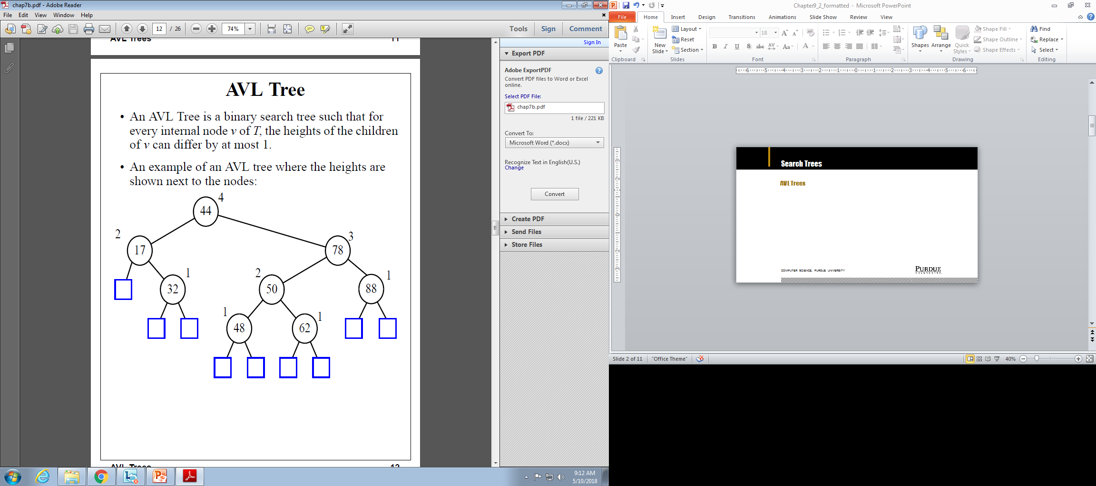
Search Trees
AVL Trees
Computer Science, Purdue University

Slide 3
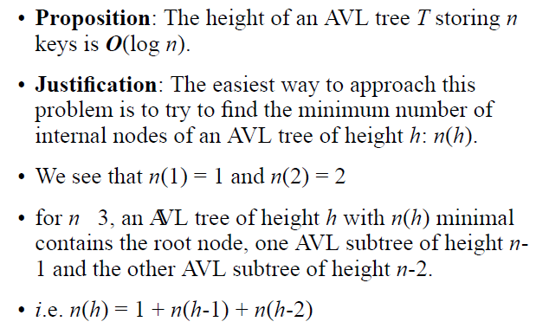
Search Trees
AVL Trees: Height
Computer Science, Purdue University

Slide 4

Search Trees
AVL Trees: Height
Computer Science, Purdue University

Slide 5
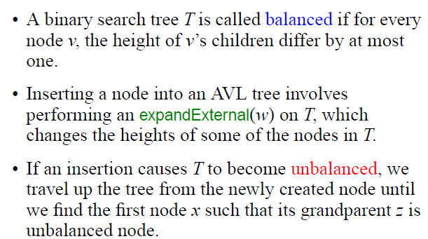
Search Trees
AVL Trees: Insertion
Computer Science, Purdue University

Slide 6

Search Trees
AVL Trees: Insertion
Computer Science, Purdue University

Slide 7
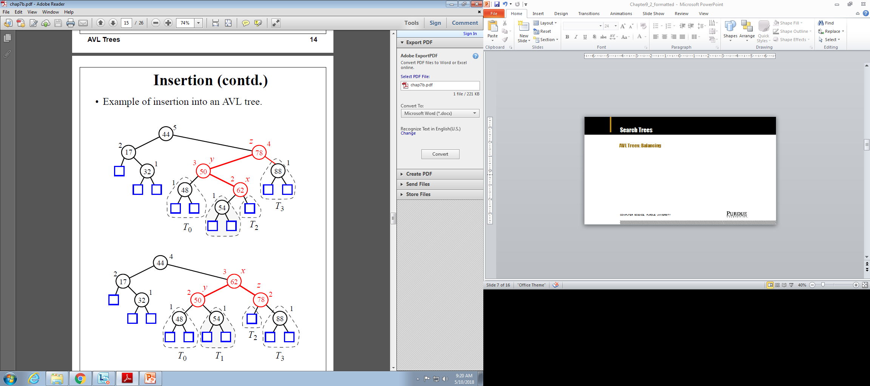
Search Trees
AVL Trees: Balancing
Computer Science, Purdue University

Slide 8
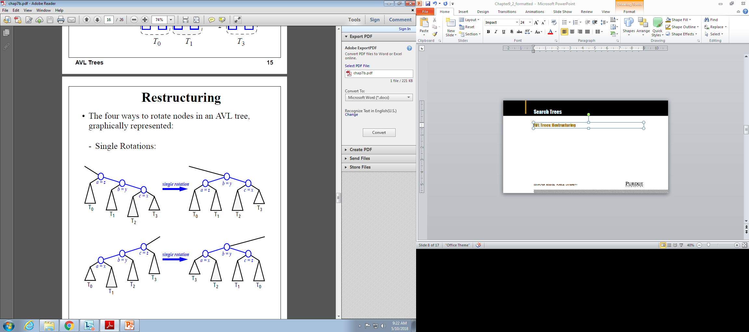
Search Trees
AVL Trees: Restructuring
Computer Science, Purdue University

Slide 9
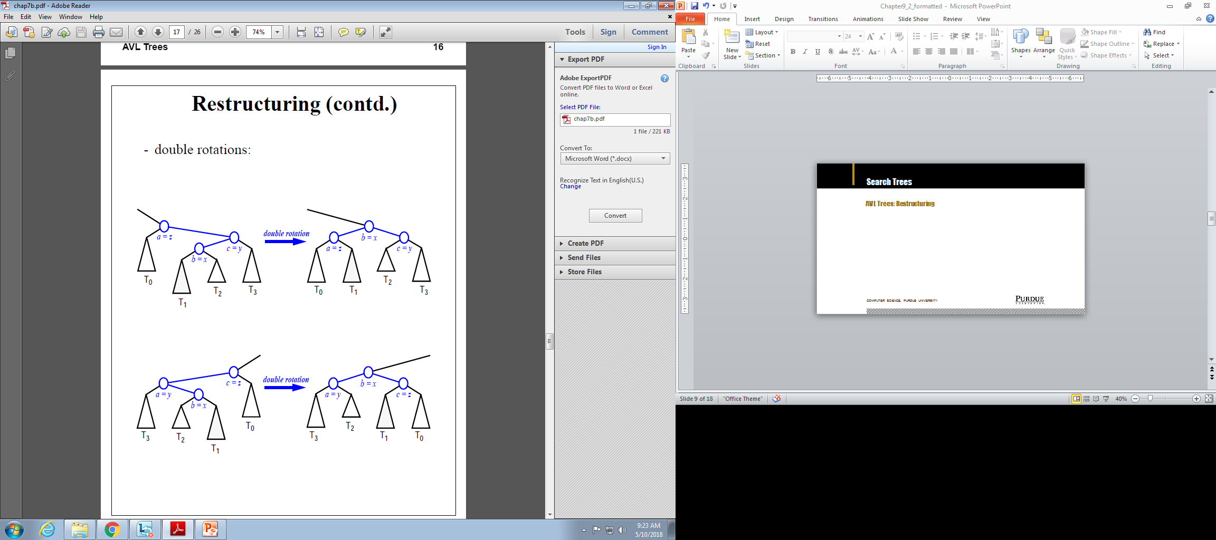
Search Trees
AVL Trees: Restructuring
Computer Science, Purdue University

Slide 10
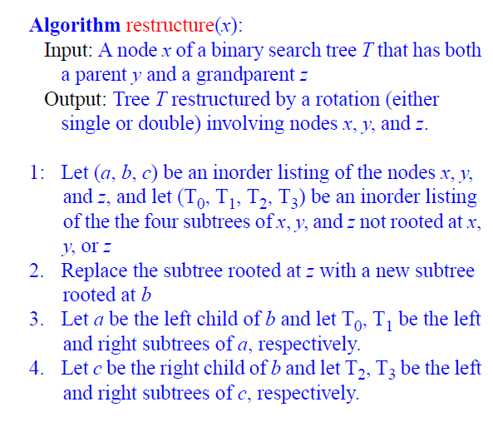
Search Trees
AVL Trees: Restructuring
Computer Science, Purdue University

Slide 11

Search Trees
AVL Trees: Removal
Computer Science, Purdue University

Slide 12
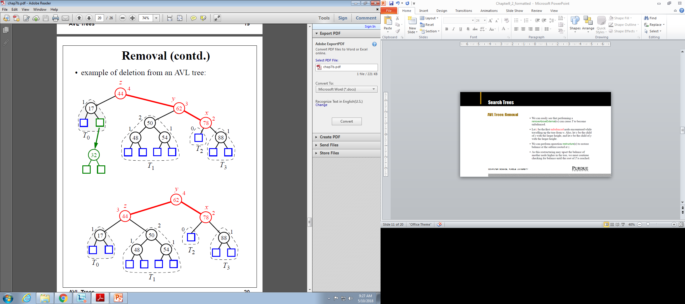
Search Trees
AVL Trees: Removal
Computer Science, Purdue University

Slide 13
Search Trees
AVL Trees: Complexities
Since the height of the tree is log (n) and all operations are O(h), all operations are O(log n).
Computer Science, Purdue University

Slide 14
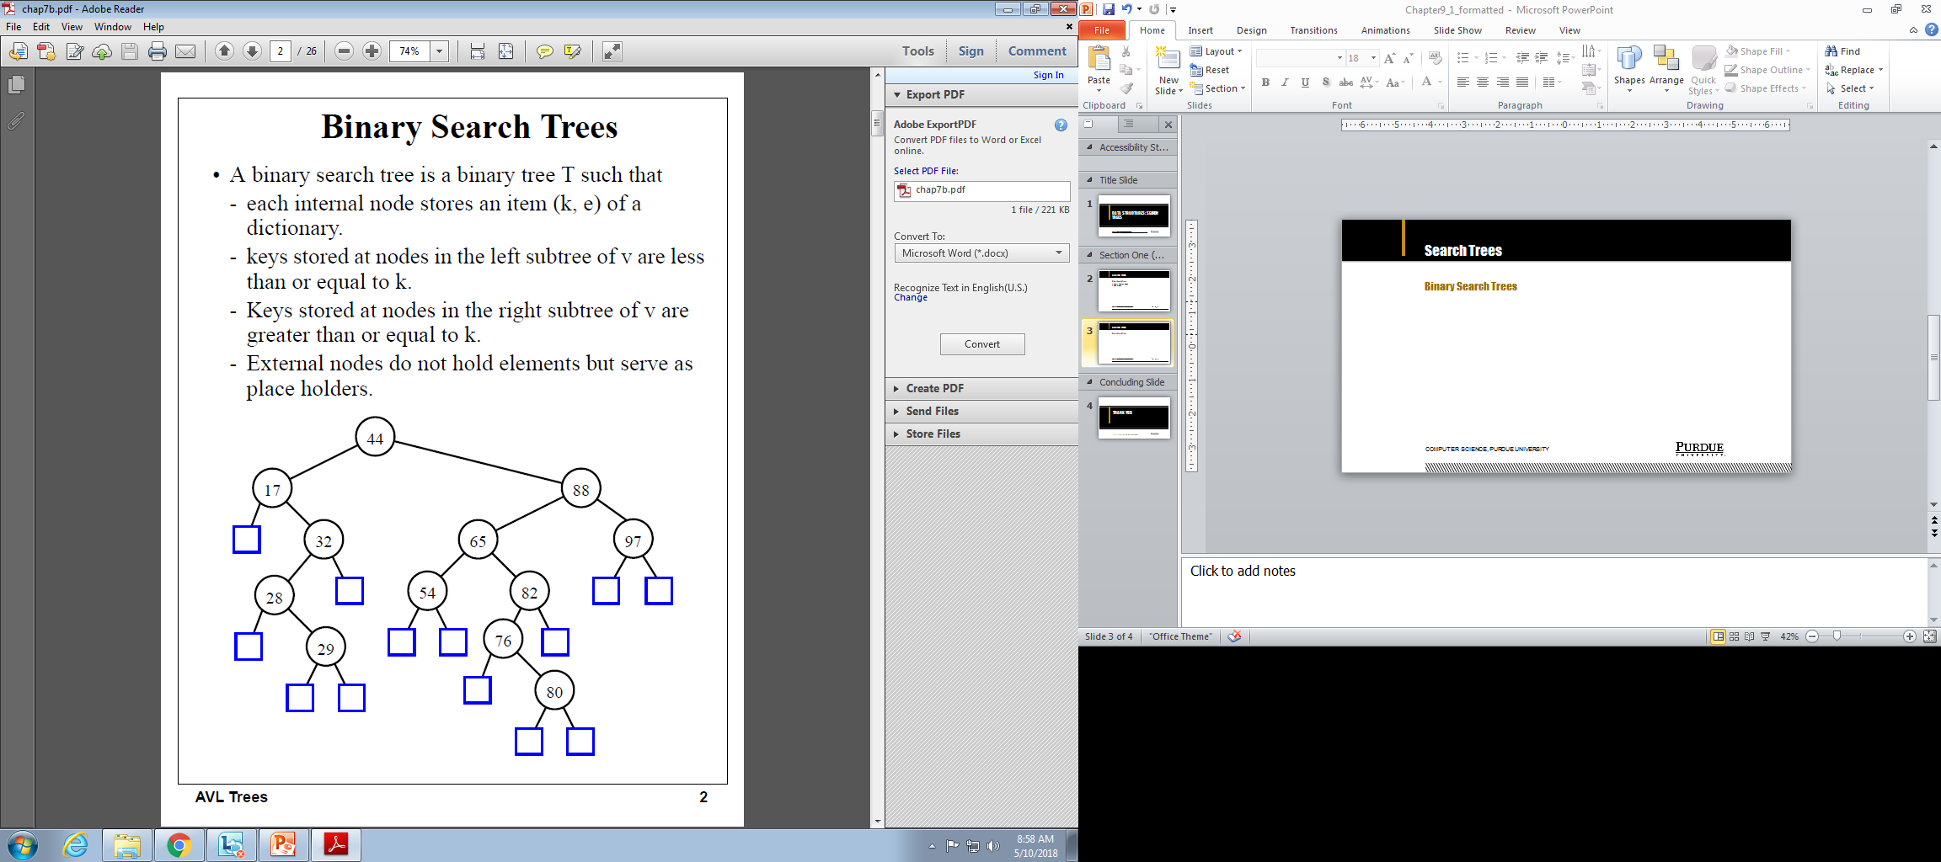
Search Trees
Binary Search Trees
Computer Science, Purdue University

Slide 15
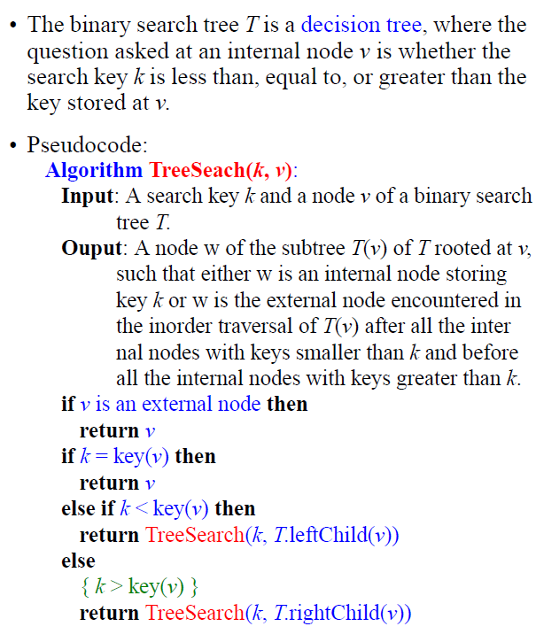
Search Trees
Binary Search Trees
Computer Science, Purdue University

Slide 16
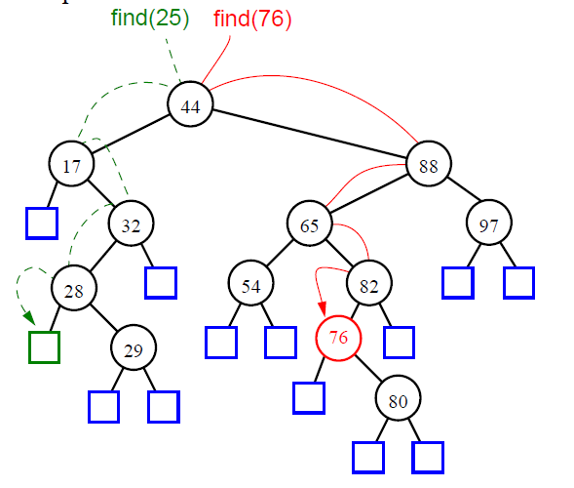
Search Trees
Binary Search Trees
Computer Science, Purdue University

Slide 17
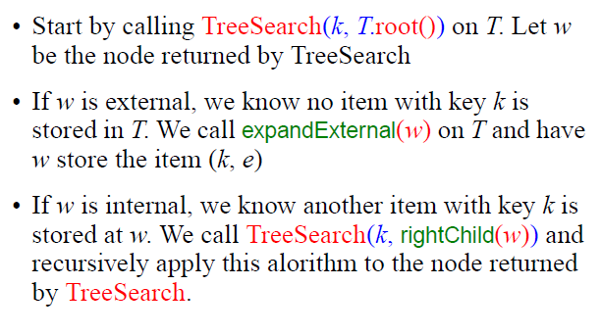
Search Trees
Binary Search Trees:
Insertion
Computer Science, Purdue University

Slide 18
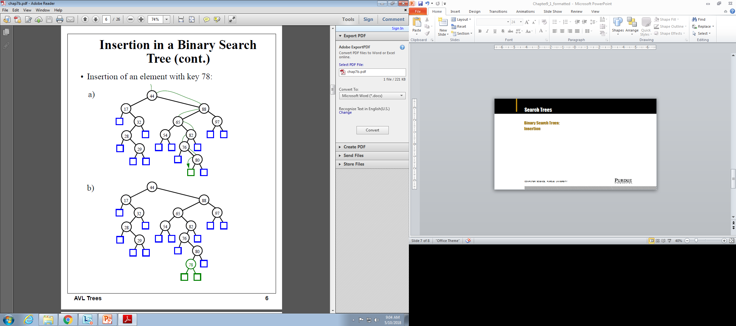
Search Trees
Binary Search Trees:
Insertion
Computer Science, Purdue University

Slide 19
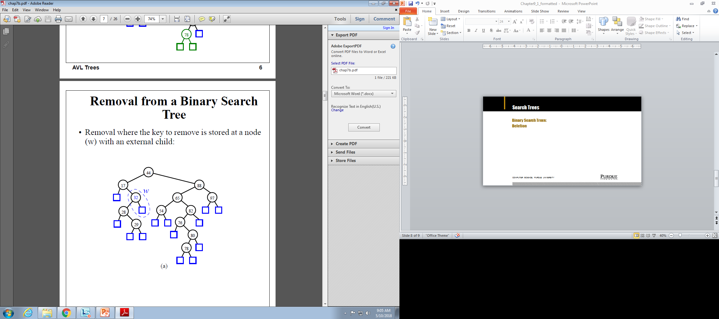

Search Trees
Binary Search Trees:
Deletion
Computer Science, Purdue University

Slide 20
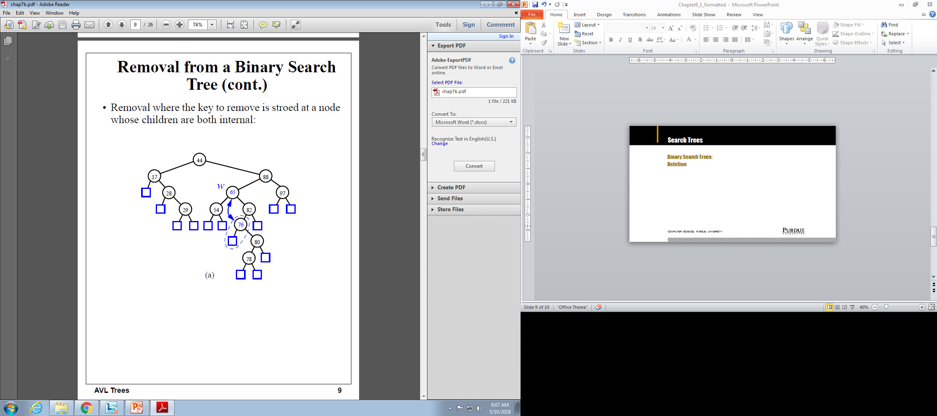
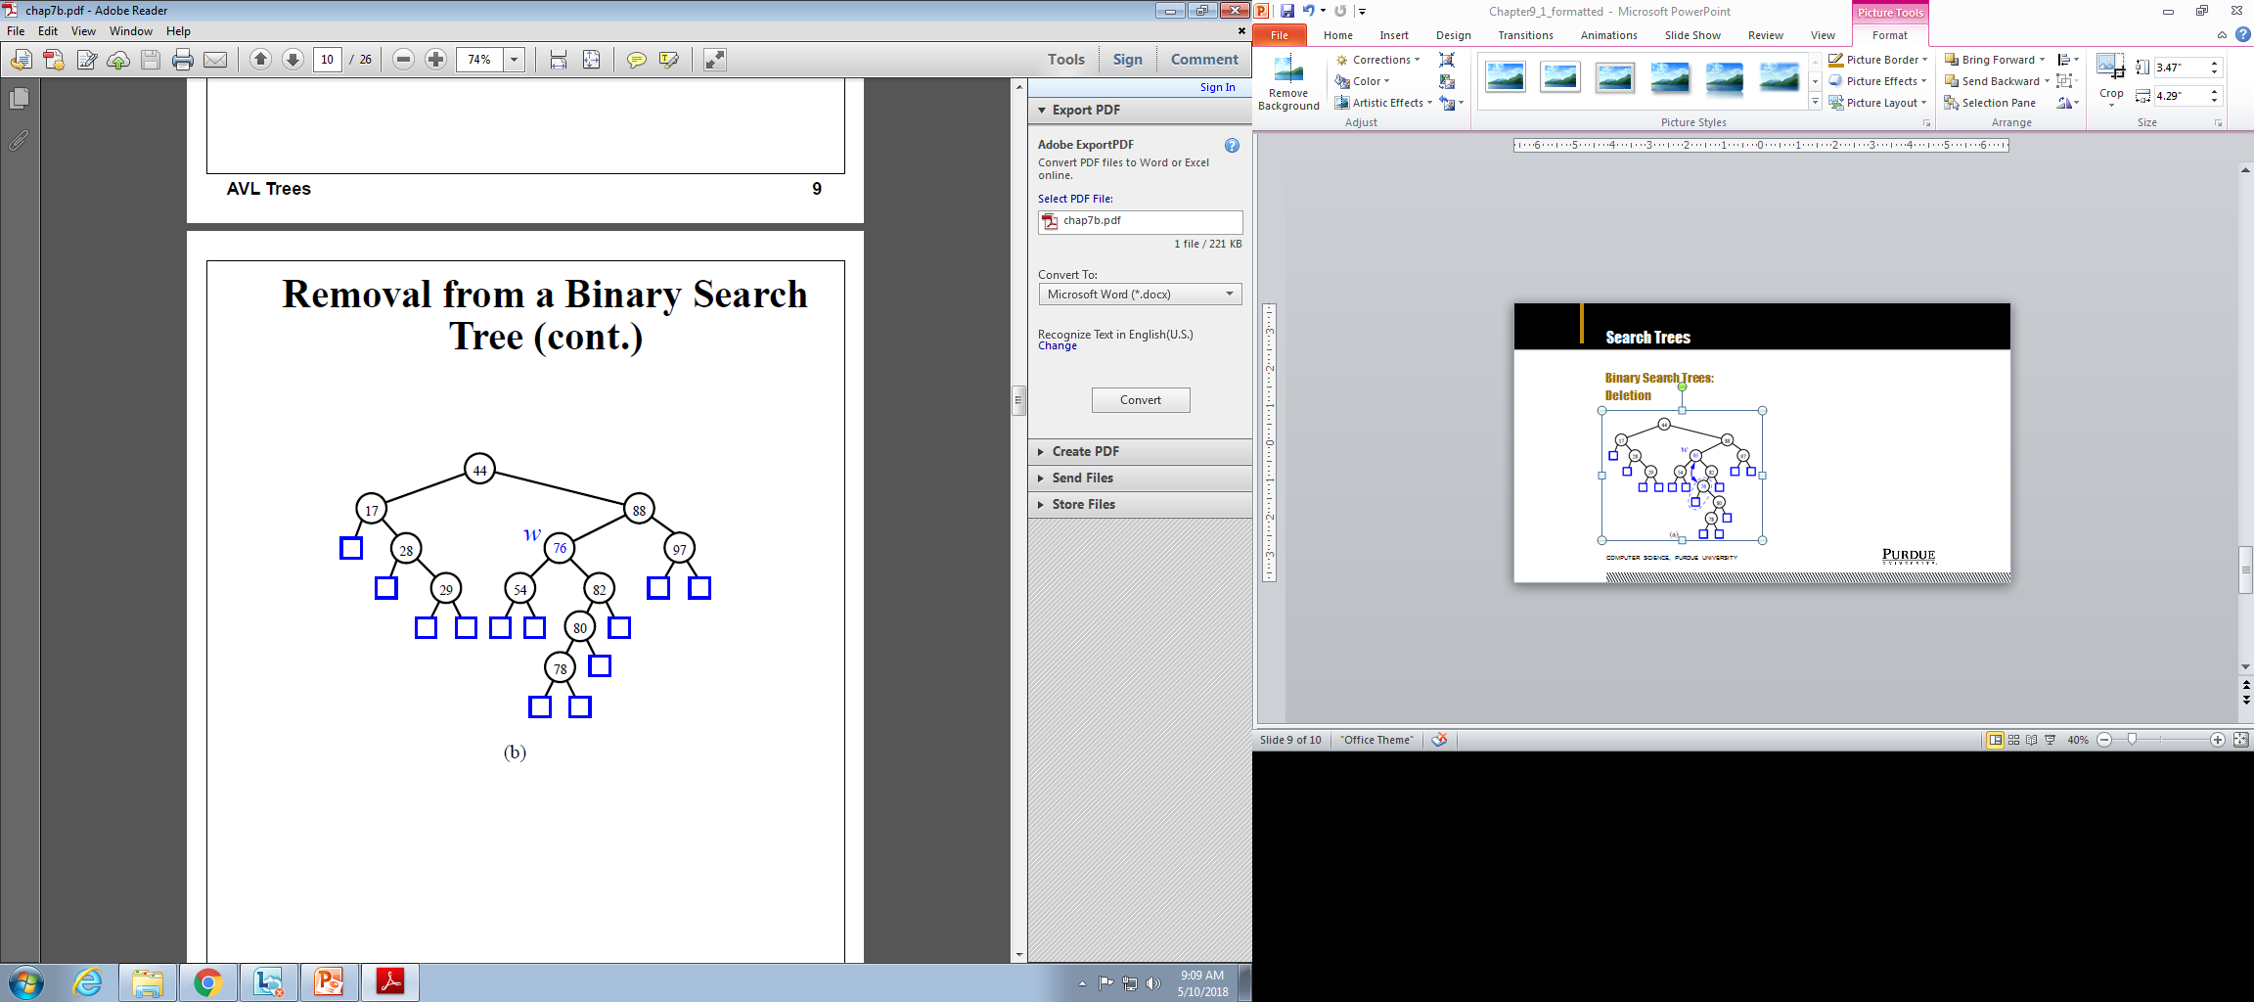
Search Trees
Binary Search Trees:
Deletion
Computer Science, Purdue University

Slide 21

Search Trees
Binary Search Trees: Time Complexity
Computer Science, Purdue University

Slide 22
Thank You

